Slide 1
SparkFun ESP8266 Thing and Microsoft Azure

Slide 2
Agenda
First Really Cool Thing
Second Really Cool Thing
Third Really Cool Thing
Fourth Really Cool Thing

Slide 3
Sign up for Azure
Best option is the Free Trial: azure.com/free
Requires a credit card for identification purposes only
Credit card WILL NOT be billed unless you authorize it
If you have signed up for a free trial before:
You can’t use the same email address to sign up again
Use a private browser session (no old accounts, cookies, etc loaded)
Sign up for a new free email address at outlook.com
Use that new email to sign up for the free trial (azure.com/free)

Slide 4
Install Pre-Reqs
Arduino IDE 1.8.x https://www.arduino.cc/en/Main/Software
Azure Storage Explorer https://azure.microsoft.com/en-us/features/storage-explorer/
Node.js 8.x http://nodejs.org
Git http://git-scm.com
Azure CLI 2.0 https://docs.microsoft.com/en-us/cli/azure/install-azure-cli
FTDI Driver https://learn.sparkfun.com/tutorials/how-to-install-ftdi-drivers

Slide 5
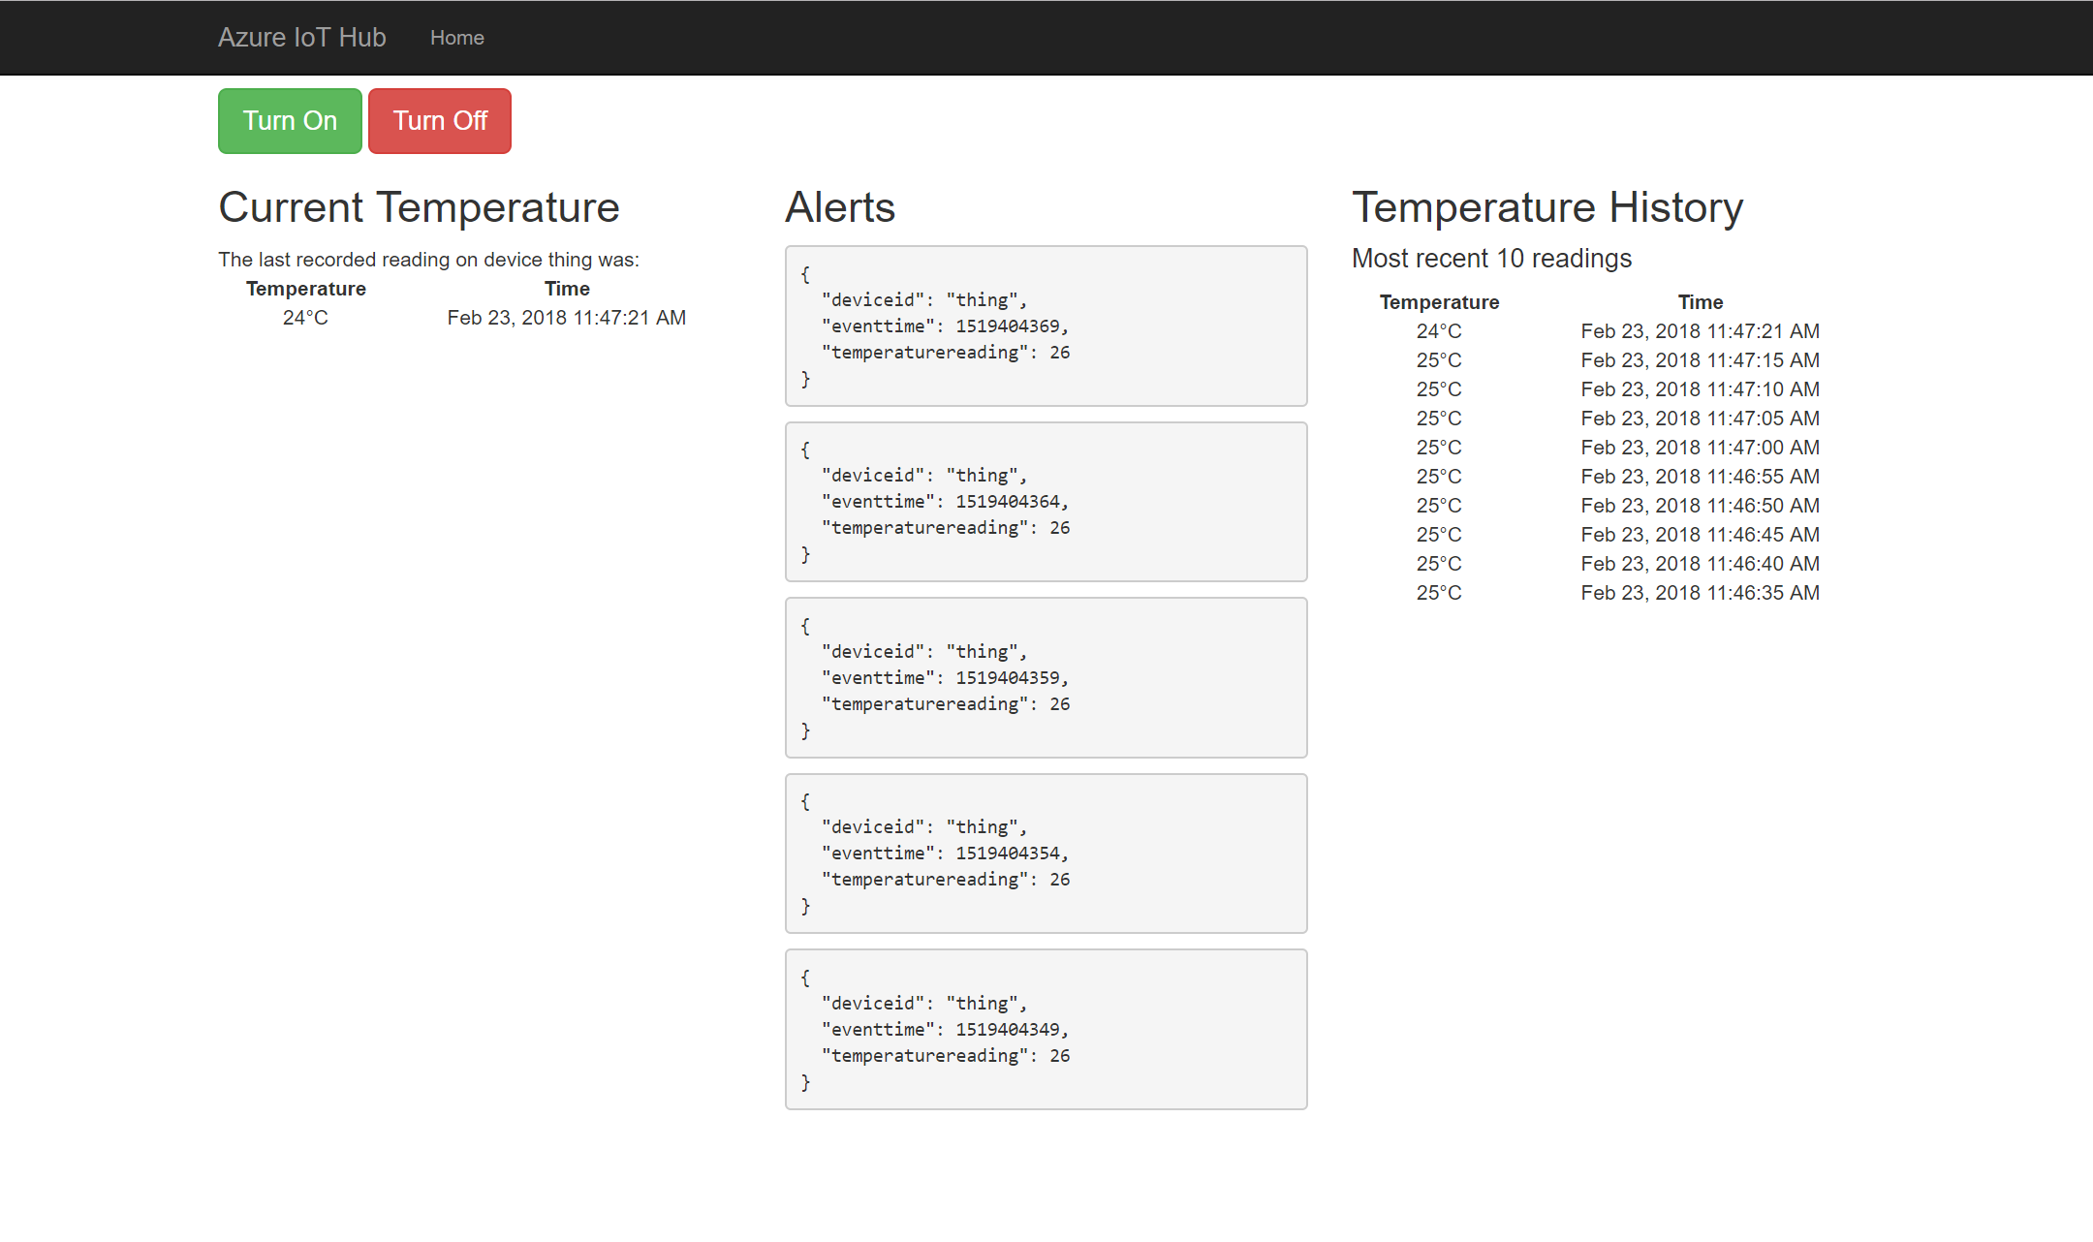
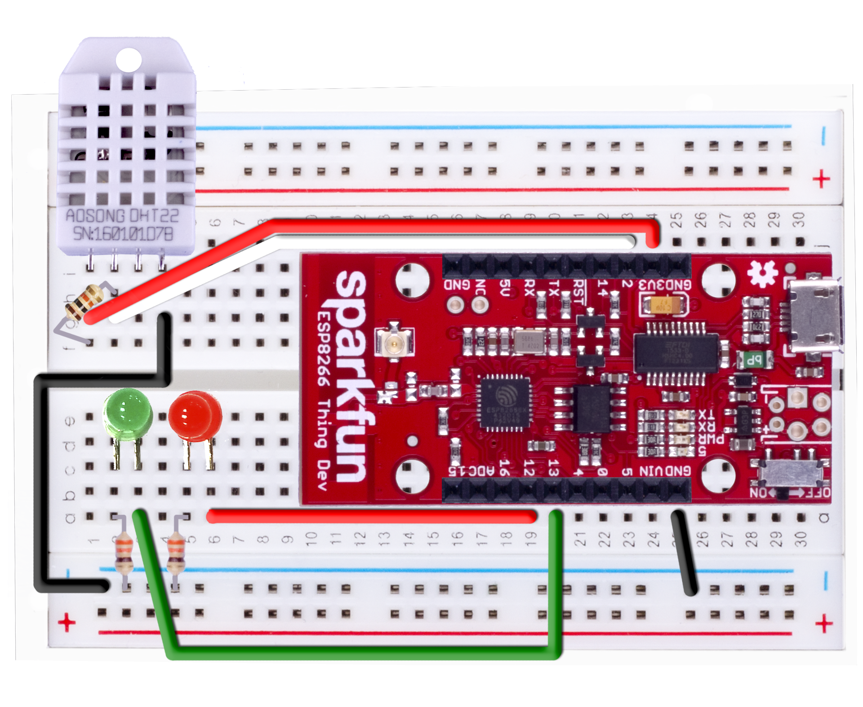
Resource Group <name>group
App Service Plan <name>plan
GET
Web App <name>web
AZURE
QUERY
RECEIVE
Storage Account <name>storage
Service Bus Namespace <name>ns
Storage Table
TemperatureRecords
Event Hub
TemperatureAlerts
OUTPUT
OUTPUT
Stream Analytics Job <name>job
INPUT
SEND C2D
IoT Hub <name>iot
Workshop
Architecture
SEND D2C
RECEIVE C2D
FIELD

Slide 6
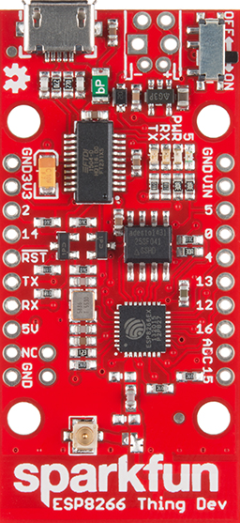

Slide 7
Do a demo!

Slide 8
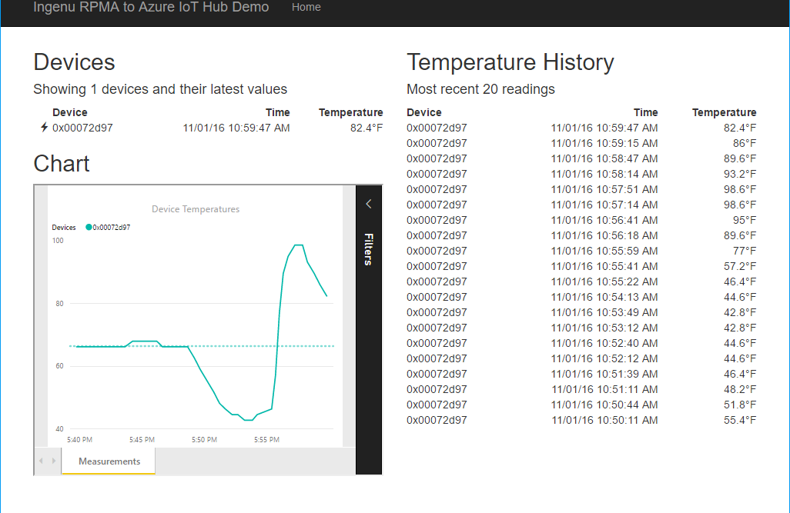


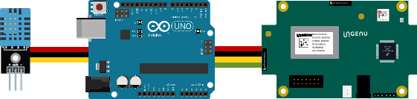
Resource Group <name>group
Power BI Embedded Collection ingenucollection
Power BI Embedded Workspace Dynamic GUID
RENDER
Power BI Report Temperature Chart
Storage Account ingenustorage
App Service Plan ingenuplan
READ/WRITE
Function App ingenufunctions
GET
Web App ingenuweb
QUERY
Function EventHub2IntellectRestJS
Function IntellectRest2IoTHubJs
QUERY
Service Bus Namespace ingenubus
SQL Server ingenusql
RECEIVE
SQL Database
ingenudb
Event Hub
ingenualerts
SEND
OUTPUT
OUTPUT
Stream Analytics Job ingenujob
POST
GET
AZURE
INPUT
RPMA to Azure
Architecture Diagram
IoT Hub ingenuhub
Ingenu Intellect Platform - REST or AMQP
INGENU
BACKHAUL
Ingenu RPMA Access Point
UPLINK
DOWNLINK
FIELD

Slide 9




Slide 10
IoT Logo

Slide 11
arduino

Slide 12
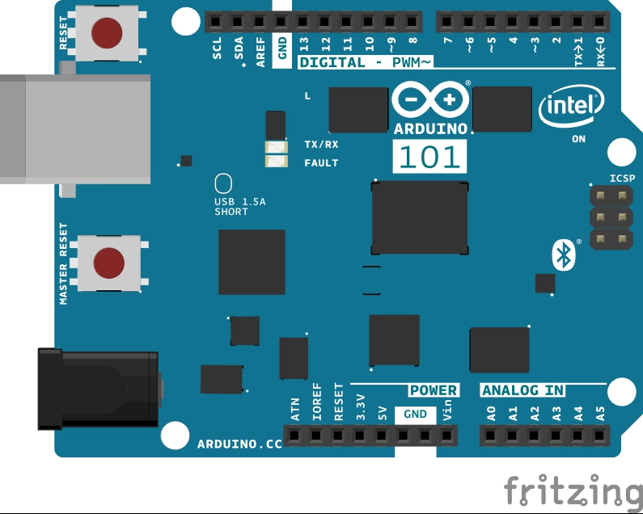
Arduino 101

Slide 13
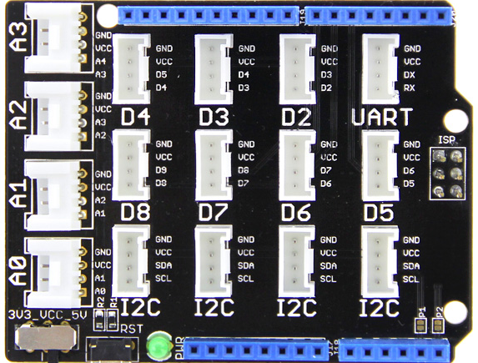
Grove Base Shield

Slide 14
Grove cable & SENSORS

Slide 15
Grove cable & SENSORS

Slide 16
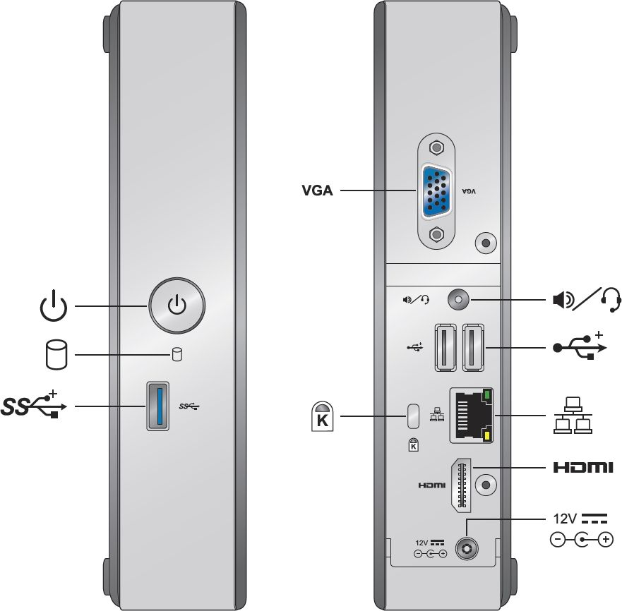
INTEL NUC DE3815TYKE

Slide 17
GALILEO BOARD

Slide 18
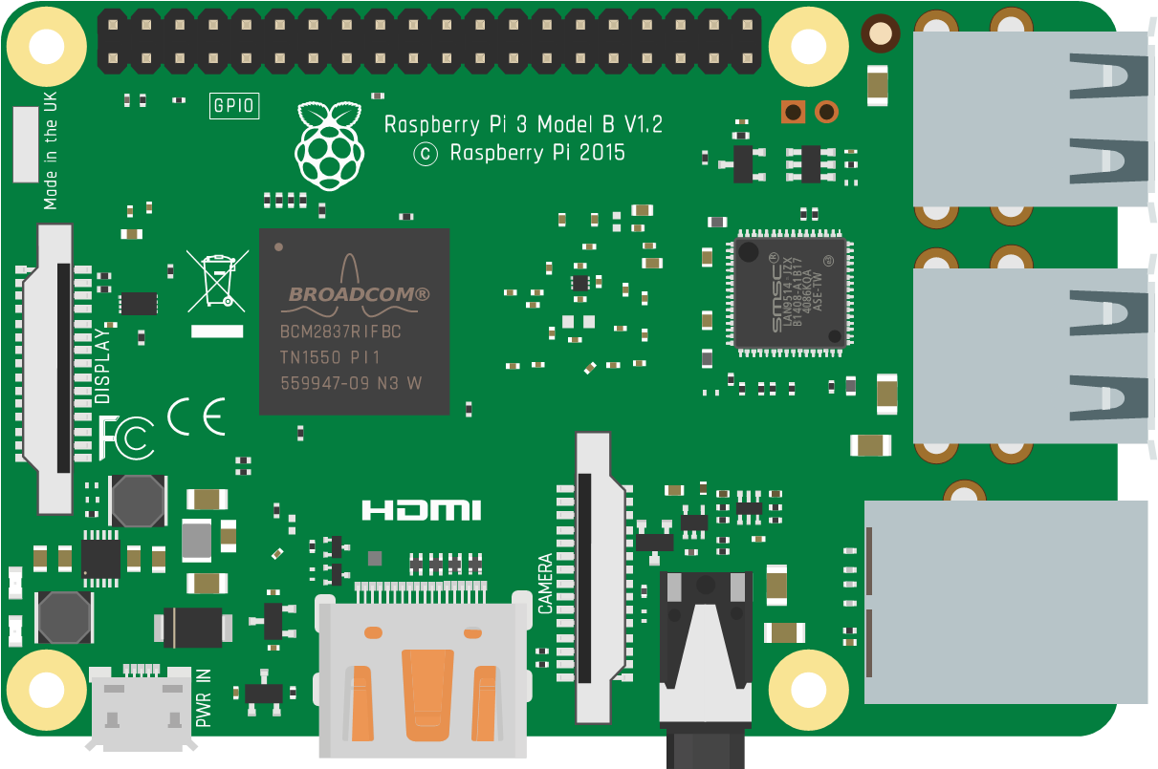
Raspberry Pi 3 PNG
https://commons.wikimedia.org/wiki/File:Raspberry_Pi_3_illustration.svg

Slide 19
RASPBERRY PI

Slide 20
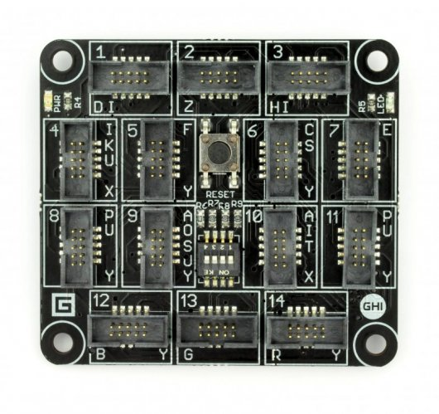
FEZ SPIDER MAIN BOARD

Slide 21
Sparkfun weather shield

Slide 22
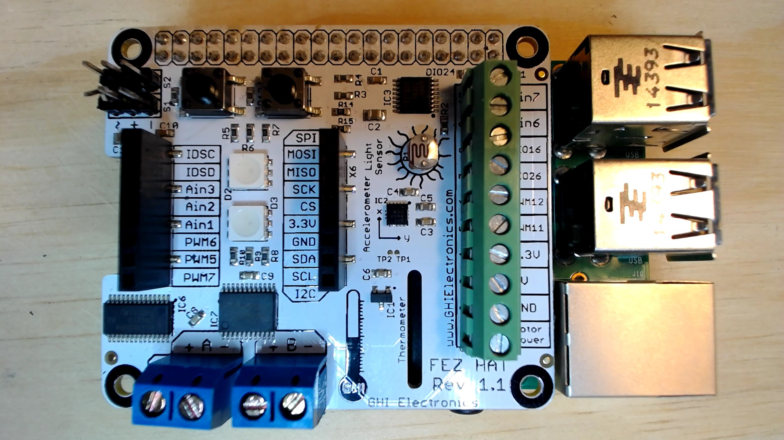
FEZ HAT

Slide 23
Device graphics from docs
Device with Filled Holes
Device with Through Holes
This is a version of the Device icon used in the “Extended IoT Scenarios” in docs. For example: https://docs.microsoft.com/en-us/azure/iot-hub/iot-hub-explorer-cloud-device-messaging

Slide 24
Connect the dots azure icons
Event Hubs
Stream Analytics
Storage
(
Azure
Microsoft Azure
Web App
Service Bus
)
Storage blob
Storage table
SQL database
HDInsight
Machine
(
Learning
GitHub code
Git repository
generic
)

Slide 25
cables

Slide 26
More cables and adapters

Slide 27

LEDs
Anode (+)
Cathode (-)
Flat Edge
Small Post
Big Post
Most reliable identification method
Long Leg
Short Leg
Vcc (+)
GND

Slide 28
LEDs

Slide 29
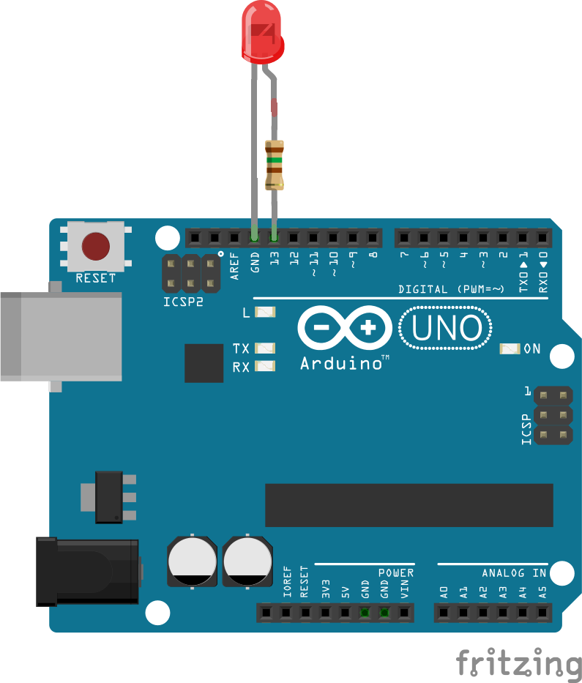
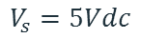
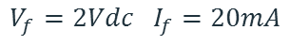
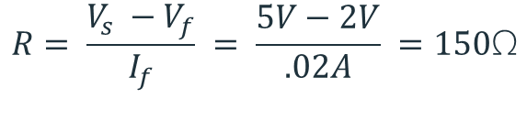

Current limiting resistors
Providing more current than an LED is rated for can destroy the LED. To prevent that, you should use a “Current Limiting” resistor.
To calculate the value of the resistor you need to know the supply voltage (Usually 5V on the Arduino Uno), and the LEDs rated Forward Voltage (the voltage drop across the LED) and Forward Current (the maximum current the LED can handle).
$$V_{f}=2Vdc I_{f}=20mA$$
$$Resistor Value (R)= \frac{Supply Voltage \left(V_{s}\right)−LED Forward Voltage (V_{f}) }{LED Forward Current (I_{f})}$$
$$V_{s}=5Vdc$$
$$R= \frac{V_{s} −V_{f}}{I_{f}} = \frac{5V−2V}{.02A} =150\text{Ω}$$
The Arduino Uno has a built in current limiting resistor on Pin 13. If you use Pin 13 to power your LED you can use it without a separate resistor.

Slide 30
Resistors
220Ω
1st Digit
2nd Digit
Multiplier
Tolerance
Color | Name | 1st Digit | 2nd Digit | Multiplier | Tolerance
 | Black | 0 | 0 | X1
 | Brown | 1 | 1 | X10 | 1%
 | Red | 2 | 2 | X100
 | Orange | 3 | 3 | X1,000
 | Yellow | 4 | 4 | X10,000
 | Green | 5 | 5 | X100,000
 | Blue | 6 | 6 | X1,000,000
 | Violet | 7 | 7
 | Grey | 8 | 8
 | White | 9 | 9
 | Gold |  |  | X0.1 | 5%
 | Silver |  |  | X0.01 | 10%
330Ω
10KΩ

Slide 31
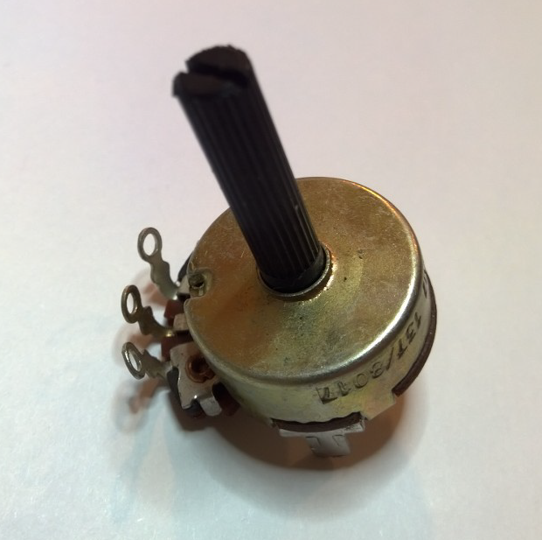
Potentiometer – variable resistor

Slide 32
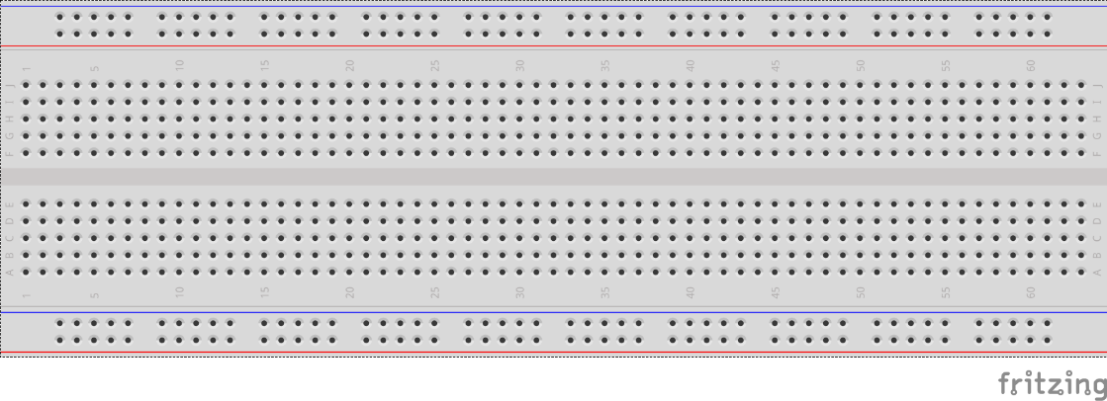
breadboards
Breadboards offer a great way to prototype circuits. The provide a number of “buses” for connecting both power and components.
Power buses run the entire horizontal length
Component buses give you easy ways to connect pins together

Slide 35
Micro SD Cards
Font: Segoe UI Semibold

Slide 36
